Slide 1
A Survey about LLM application to Financial Texts – Peng Chen
CS 8803
Notes:
Hello, everyone, I am Chen Peng. I am presenting my paper for CS 8803 of online Master of cs. The topic is “A survey about LLM application on Financial Texts”. This is a literature review paper

Slide 2
Contents of this presentation
Introduction | To give an overview of this survey
Background | Share background information for listeners
Review Process | How we search for papers of different topics
Steps to apply LLMs on Financial Texts | What to do if a listener wants to reproduce the experiments or apply LLMs on financial texts
LLM Applications in Financial Texts | A taxonomy of LLMs’ applications in financial texts
Potential Issues | Potential security and fairness issues when applying LLMs to financial texts
Conclusions and Future Work | A summary of what we found and what to research in the future
Notes:
Ok. There are 7 sections in this presentation in total. They are introduction, an overview of this survey; background to share background information for listeners. Review process, to explain how we search for papers of different topics; steps to apply LLMs on financial texts, what to do if a listener wants to reproduce the experiments or apply LLMs on financial texts. Then I will give a taxonomy of LLMs’ applications in financial texts; At last, I would share potential security and bias issues when applying LLMs to financial texts, and summarize what we found as well as what to research in the future.

Slide 3
1. Introduction
Research questions
Our contributions
What LLMs?
What are the steps to apply LLMs to financial texts?
What are the potential issues and future research directions?
We are the 1st survey
We summarize the steps
We raise a taxonomy of applications
We analyze the potential security or bias issues
Notes:
Firstly, let’s have an overview of this survey. This survey has 3 research questions:
1. What LLMs could be applied to financial text manipulation? How do they perform?
2. What are the steps to apply LLMs to financial text?
3. What are the potential issues and future research directions for applying LLMs to financial text?
Our contributions include
1.We are the 1st survey about LLM application to financial texts
2.We summarize the steps to apply LLM to financial texts
3.We raise a taxonomy of application of LLMs to different tasks related to financial texts
4. We analyze the potential security or bias issues LLMs may face when manipulating financial texts.

Slide 4
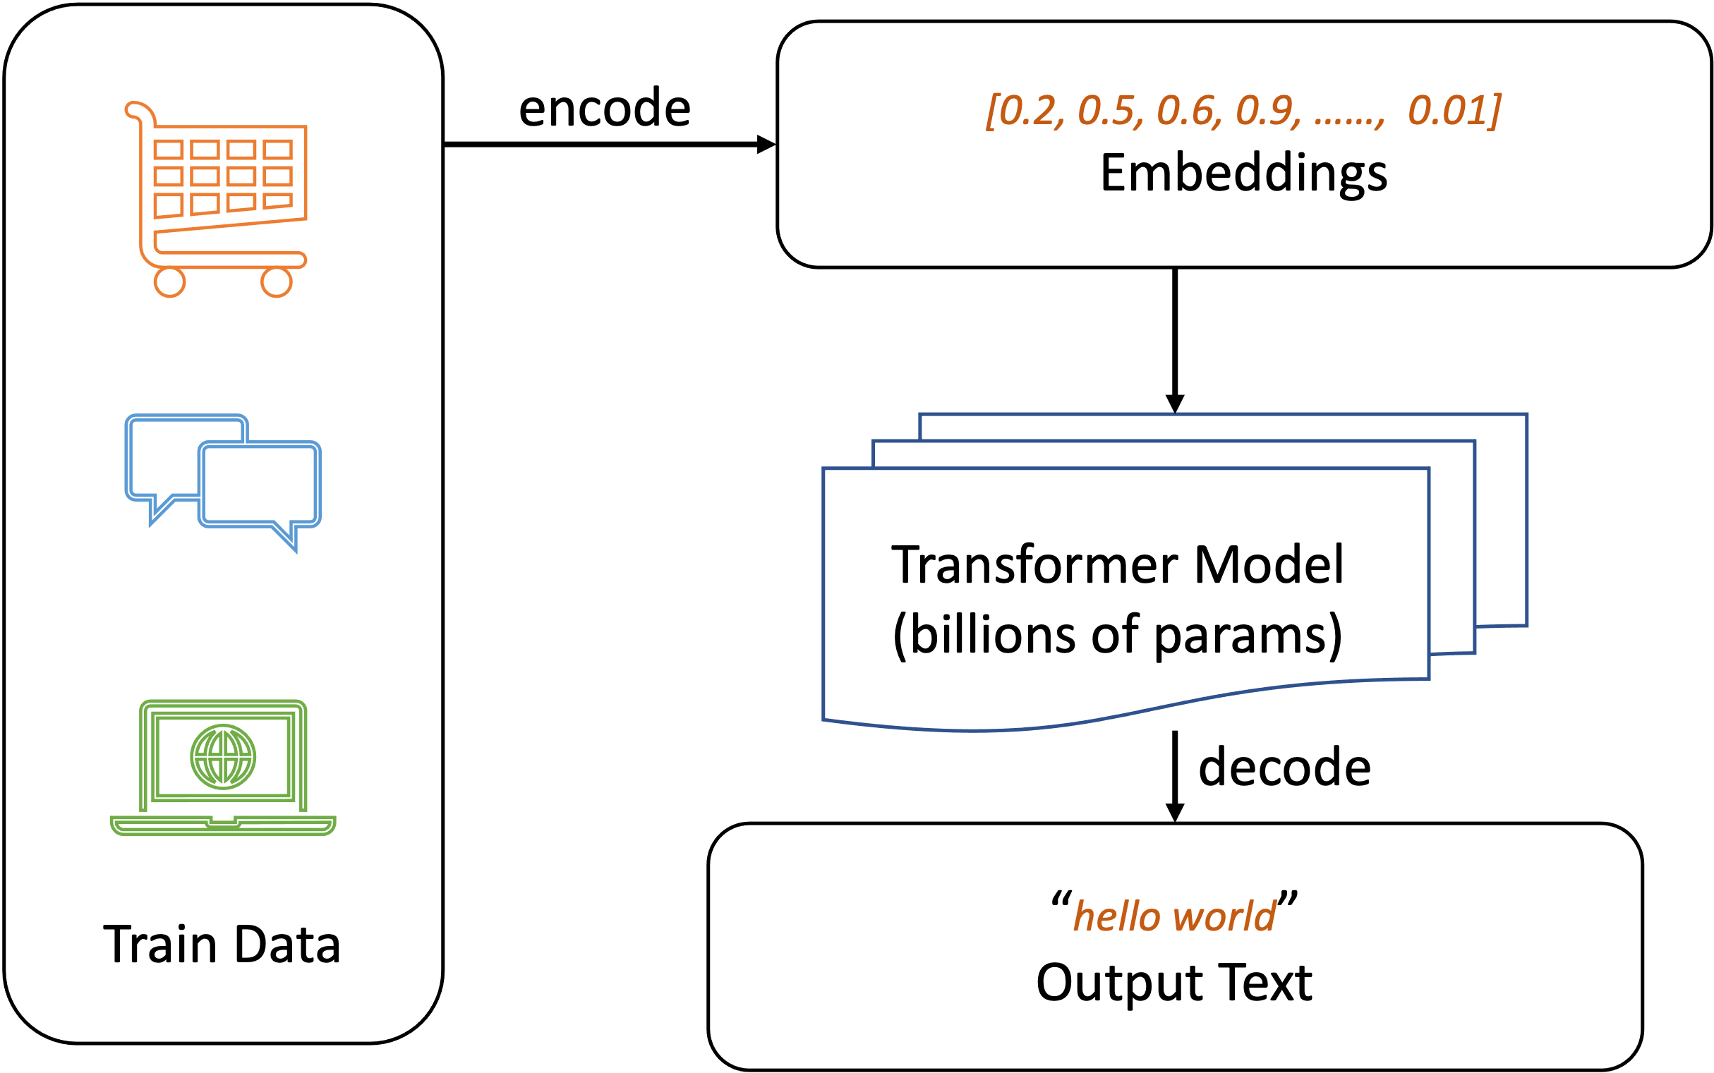
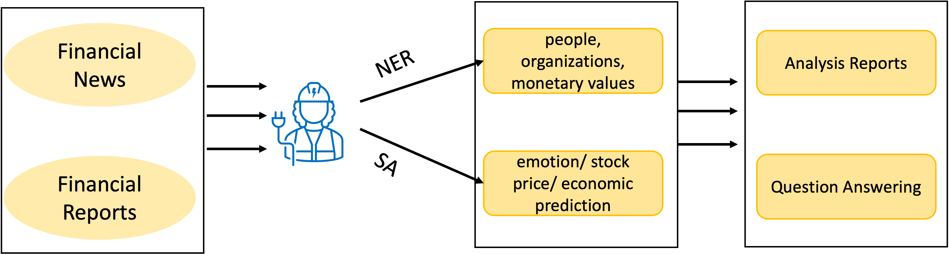
2. Background
Financial Analysis Workflow
LLM Background
Notes:
I would wile to give some background information for listeners about financial analysis and LLM
Firstly, financial analysts need to cope with a lot of textual data. Like what’s shown in the picture, The financial analysts can read financial news or reports and then extract company names, predict the company would have a better or worse future, and write reports to summarize the content of what they read or answer questions about their point of view for the future.
LLMs are large language models based on transformer and trained with a huge amount of data from the web or other sources encoded. The models usually contain billions of parameters. A notable application of LLMs is ChatGPT, which builds on the GPT series to enable dialogue, demonstrating an impressive capacity for human-like conversation.

Slide 5
3. Review Process
Keywords | Paper Topics
LLM Finance NER / LLM NER | Information Extraction
Sentiment Analysis LLM | Sentiment Analysis
LLM Writing Report / LLM Financial Report | Generating Reports
LLM Finance Question An- swering / LLM Question An- swering | Question Answering
LLM Security/ LLM Secu- rity Issues | Security Issues of General LLMs
LLM Bias/ LLM Fairness/ LLM Bias Issues | Bias Issues of General LLMs
Notes:
For the review process, we mainly use the database of IEEE Xplore Digital Library, ACM Digital Library, Science, mediaTUM, SSRN, Arxiv and so on.
We use keywords of this table to search for papers

Slide 6
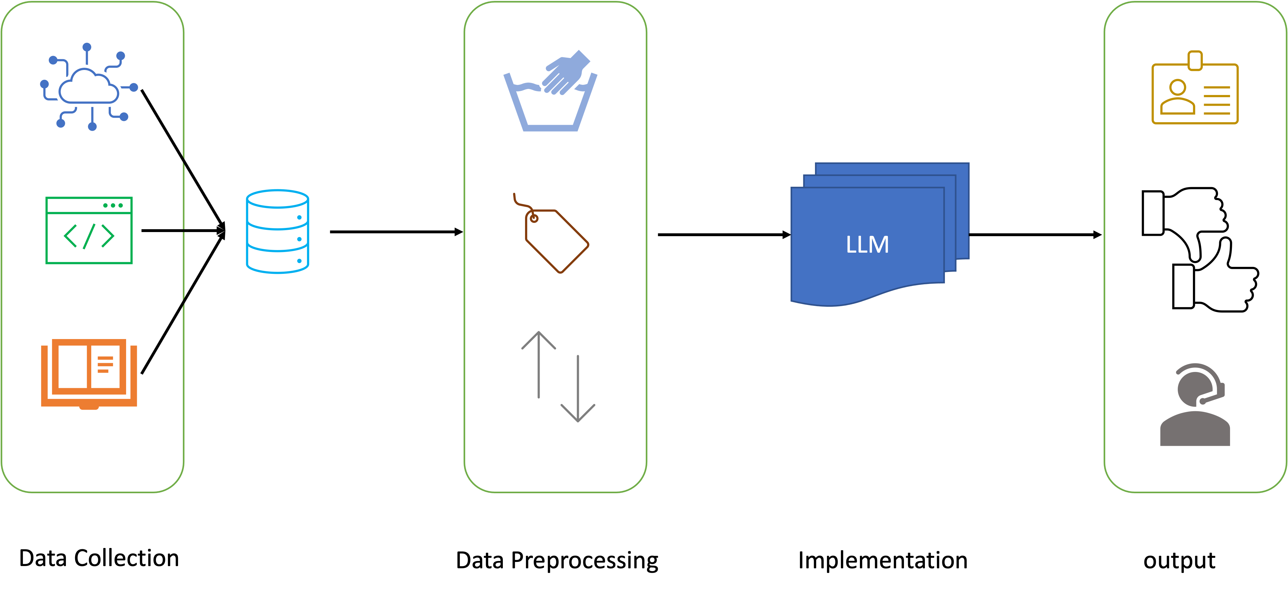
4. Steps to apply LLMs to financial texts
Notes:
For the people who want to apply LLMs to financial texts or reproduce the experiments
Firstly, if we want to fine-tune a general model for financial usage or do experiments to test LLMs’ performance, we need to collect texts about finance from the Internet or other sources.
Then we need to clean the data, such as move outliers, move empty records, label the datasets for model fine-tuning or validation.
Then we feed the encoded texts to LLM models and get output in the form of named entity(for NER task), positive or negative prediction(for SA task), or answers(for QA task).
We can do our work on the outputs.

Slide 7
5. LLM Applications to Financial Texts
LLMs for Reading
LLMs for Writing
Information Extraction
Sentiment Analysis
Report Generation
Question Answering
Notes:
We split the applications to 2 major categories, reading and writing.
For reading, we want to know how much LLMs could understand the meaning of financial texts.
We split the reading into information extraction and sentiment analysis. Information extraction is equal to NER, we survey how LLMs perform on this task about extracting people, company names or other organization names from texts. We can see that many models claim to have very high accuracy for this task
Another import task is sentiment analysis, which is to predict whether a report or news is positive or negative. We found that most models can achieve an accuracy of over 80% given certain conditions.
Unfortunately, we didn’t find LLMs exclusively designed for financial report generation. But there are some models that are more general in this task, like Automatic Text Summarization or automatic survey generation, and they claim to have similar outcomes as human-beings.
For the task of question answering, many models claim to have a very high accuracy. But some experiments show that the models are not good enough to use in financial companies.

Slide 8
6. Potential Issues
Security Issues
Bias Issues
Member Inference Attack
Data Leakage
Differential Privacy
Gender
Race
Other properties
Notes:
As the emergence of the LLM. Many potential issues still require further investigation.
For security issues, financial data is always confidential, so member inference or data leakage would be a serious problems.
Besides protecting data, one of the effective mitigations is differential privacy.
Models are always trained with data from the Internet. If the data contains biased records, the model inherently has similar bias based on gender, race and other properties for the outcome

Slide 9
7. Future Direction
Specific tasks
More empirical analysis and performance benchmarks
Multimodal LLMs
Notes:
At last, this paper gives some future directions.
Firstly, there are no models deigned for some specific tasks like financial report generation, this kind of models can be designed.
Many models claim to be accurate, but there are not many empirical experiments to test their performance and accuracy. More empirical analysis can be done to guide usage in real financial industry.
As the development of LLMs, more forms of data like voice, image and video, are incorporated into LLMs. Can these multimodal LLMs help with financial textual tasks? This could also be future investigated.

Slide 10

Thanks !

